Slide 1
ICP District Energy 3rd Technical Forum Meeting
Version 1.0 presentation
April 25th, 2018
Luís Castanheira, ICP Europe Technical Director
Bethan Phillips, ICP Europe Technical Team

Slide 2
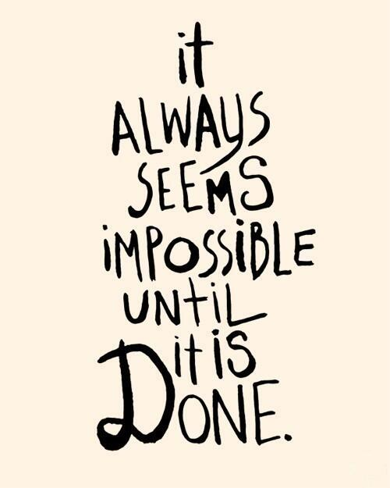
Agenda
Version 1.0 presentation
Next steps
Other issues

Slide 3
Baselining approach
IPMVP Option C is the appropriate M&V approach under this protocol. The measurement boundary will be drawn around the buildings to be connected to the DE network, including the plant and associated distribution system that is supplying their thermal energy. Ancillary energy consumption associated with delivering the thermal energy may be excluded under the baseline condition if considered de minimus or consistent with the equivalent consumption for the proposed scheme.
Guidance on developing baselines can be found both in EVO 10000 – 1:2016, IPMVP Core Concepts and ISO 50006:2014 Energy Management Systems – Measuring Energy Performance Using Energy Baselines and Energy Performance Indicators.

Slide 4
Savings calculations
For district energy projects, energy savings will be based on the difference in energy consumption pre- and post-implementation to deliver the required thermal energy to the end consumers which are going to connected to the network.
Calculations for this type of project should include all energy conversion, transmission and distribution losses for a centralised energy supply.

Slide 5
Savings calculations
Calculations of estimated savings for projects using this protocol must be based on transparent calculation methods or tools. All savings calculations must be based on sound engineering methods, and be consistent with the following core IPMVP principles: best practice, accuracy, completeness, conservativeness and transparency.
The results of the savings calculation process should also be calibrated to data on the performance of existing schemes or of past projects. Energy savings calculations must be developed using open source tools. However, supporting calculations may require the use of proprietary tools.

Slide 6
Savings calculations (on qualifications)
Choose an individual to perform energy savings calculations with one of the following:
Nationally/Internationally recognised energy savings calculation certification,
or
At least three years experience in developing energy savings calculations for District Energy projects, documented in the form of a CV outlining relevant project experience.

Slide 7
Design, Construction and Verification
Appoint an Operational Performance Verification Resource: A specified OPV resource shall be named in the OPV Plan who has one of the following qualifications:
Nationally/Internationally recognised commissioning certification,
or
Three years or more of commissioning experience in district energy projects, documented in the form of a CV outlining relevant project experience.
Develop an Operational Performance Verification Plan(pre-construction)

Slide 8
Operations, Maintenance and Monitoring
Select and document ongoing management regime including either periodic inspection, automatic Monitoring and Targeting (aM&T) reporting, software-based monitoring and fault detection, periodic recommissioning, or a combination of these approaches.
Develop an Operations, Maintenance and Monitoring Plan(pre-construction)

Slide 9
Measurement and Verification:
The M&V efforts must fully comply with applicable sections of IPMVP Core Concepts-2016 Option C.
Appoint an M&V Professional during the certification period who meets one of the following sets of requirements:
Association of Energy Engineers (AEE) Certified Measurement & Verification Professional (CMVP) certification, or
At least three years of demonstrated M&V experience documented in the form of a CV outlining relevant project experience
Develop an IPMVP based M&V Plan as early in the project development process as possible that adheres to the IPMVP Core Concepts-2016, Section 7.1.
Notes:
What about the other requirements e.g. description of OPV report…

Slide 10
Next steps
Protocol public release
Develop PD and QAP training materials – May
PD and QAA Trainings - September
Pilot projects
Other issues?

Slide 12
Contacts
Luís Castanheira
Technical Director, ICP Europe
+351 932454711
luis.castanheira@eeperformance.org
Jorge Rodrigues de Almeida
ICP Europe Director for industry, district energy and street lighting
+351 964738413
almeida@rda.pt
europe.eeperformance.org
@icpeurope
This project have received funding from the European Union’s Horizon 2020 research and innovation programme under grant agreement No 754056. The sole responsibility for the content of this document lies with the authors. It does not necessarily reflect the opinion of the European Union. Neither the EASME nor the European Commission are responsible for any use that may be made of the information contained therein.

